Slide 1
Lightning Talk 1:
Product Research
sdmay25-12
Team members:
Bilal Hodzic, Sabrina Francis, Nathan Turnis, Zane Lenz, Ivan Santoy, Aina Azman, Osaid Samman

Slide 2
Pressure Sensor Patch Objectives
Develop a flexible pressure sensor patch to help individuals, including adaptive sports athletes, prevent pressure sores. The patch will monitor pressure in real-time and provide alerts via a mobile app, allowing users to take immediate action, enhancing both health outcomes and athletic performance.

Slide 3
Problem Statement
Individuals with limited mobility, including adaptive sports athletes, are at high risk of developing pressure sores due to prolonged pressure on specific areas of the body.
Current solutions often lack real-time monitoring and timely intervention, leading to severe complications.
This project aims to create a flexible pressure sensor patch that continuously monitors pressure levels and provides real-time alerts to prevent pressure sores, improving both health outcomes and quality of life for users.

Slide 4
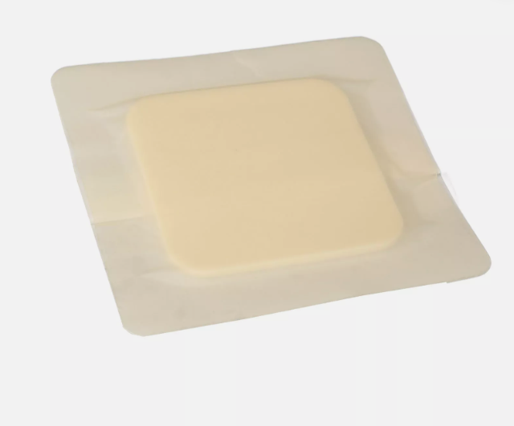
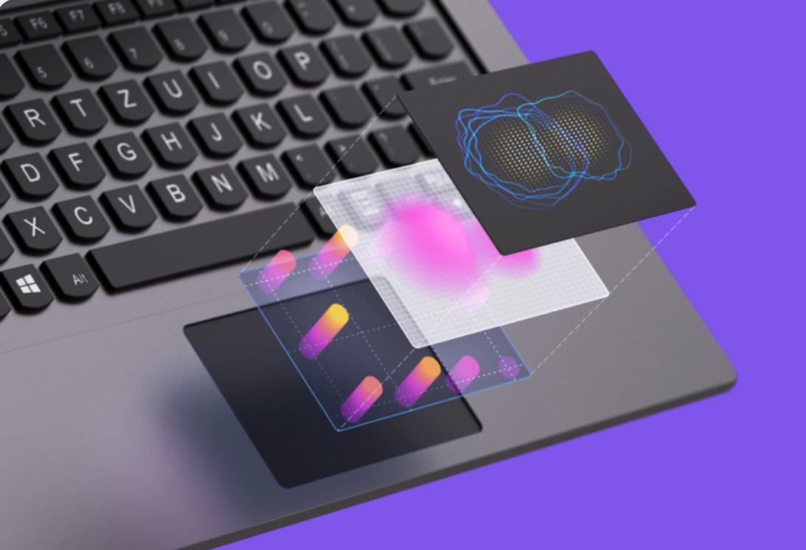
Related Products
Product | Description | Product Image
Bordered Hydrocolloid Pressure Sore Patch | Protects an area from pressure sores with a pressure absorbing foam
Haptic Touch pad with capacitive grid to localize areas experiencing high pressure differences | Device for checking for large pressure differences between areas

Slide 5
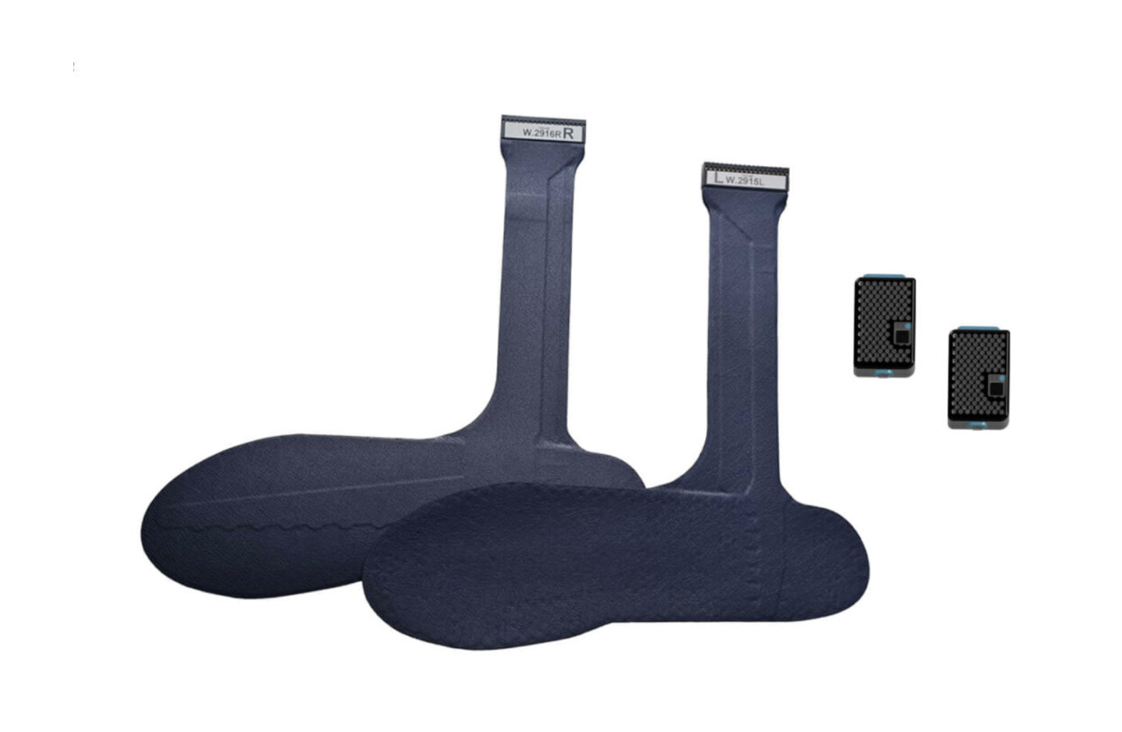
Related Products
Product | Description | Product Image
Pedar insole systems | Shoe soles for tracking pressure on the bottom of feet. Links to a computer to see data visualized

Slide 6
Market Gap
Existing products are not designed to be placed on the skin in a flexible, compact form.
From our research, there are no wearable pressure sensor patches that match the robustness and functionality we aim to develop.
None of the available solutions are tailored for physical activities.
Current products do not offer connectivity to mobile devices for real-time monitoring and alerts.

Slide 7
New Ideas Generated from Product Research
Develop a flexible sensor that adheres to the skin and monitors pressure levels in real-time. The sensor will transmit data wirelessly to a mobile app, allowing users to receive alerts and make adjustments to prevent pressure sores.
Skin-Adhering Sensor
Design a soft fabric embedded with pressure sensors to track pressure across multiple zones. This fabric can be integrated into clothing or mobility aids and will send data to a mobile app, offering real-time pressure mapping and insights, ideal for adaptive sports.
Soft Fabric Pressure Tracker

Slide 8
Conclusions
Most existing solutions lack the versatility needed for widespread use.
Our goal is to develop a generic pressure sensor patch that can be applied anywhere on the body and used by anyone, without requiring additional hardware.
This flexible, user-friendly solution will provide effective pressure monitoring with minimal setup, making it ideal for a wide range of users.

